Slide 1

NGOs

Slide 2
CHECK IN:
INTRODUCE YOURSELF

Slide 3
INTRODUCTION

Slide 4
ETHEREUM
→ Database - Spreadsheet: Saving info
→ Bank Account: Saving info in a way that info can only be added not modified
→ World Computer: for running computations & algorithms

Slide 5









WEB2 or Corporate Web
APPS
CENTRALIZED
CENSORABLE
DATA-TAMPERING
OPAQUE
Terms of Service based TRUST
PUBLIC
INTERNET
Notes:
ema feed: in WEB2 insert banks

Slide 6



Centralization can be efficient but can have side effects...
APP / CENTRAL AUTHORITY
RESULT
FINANCE
VOTING
BROADCASTING
NETWORKING
DELINQUENCIES
MANIPULATION
CENSORSHIP
DATA POLICY
Notes:
ema feed:
explain why the BC had to do with the Deep Web
explain the daily practices that we consider “accepted” and instead represent a “grey area” that can benefit from blockchain
examples or grey areas per Finance: subprimes (and GameStop phenomenon); Voting: Piattaforma Rousseau, Google; Broadcasting: YT and dictatorships; Networking: Facebook.

Slide 7
What are the purposes of voting in NGOs?
OBJECTIVE | PROCESS | OPERATED BY
POLITICAL / STRATEGIC decisions | Online assembly | Third Parties Services
Administrative Budgeting financial | closed doors | committees
Line Management | Informal basis (pvt communication) // hierarchy of levels | Director/CEO
Notes:
POLITICAL/STRATEGIC DECISION
Elections
Strategic Planning
ADMINISTRATIVE
Budgeting
LINE MANAGEMENT
definition of processes and responsibilities, approval of outsourcing (rules for outsourcing) → bounty contract (can apply only if whitelisted) w/ CoreGovernance
WHAT? Suggestions
Social Budget
Strategic Planning
Elections

Slide 8
What are the pros and cons of voting as it is today?
 | PROS | CONS
OFFLINE | secretive | barriers of entry expensive reliability of ballot
ONLINE | logististics quicker consultations | security manipulation if centralized (before the destination servers)

Slide 9

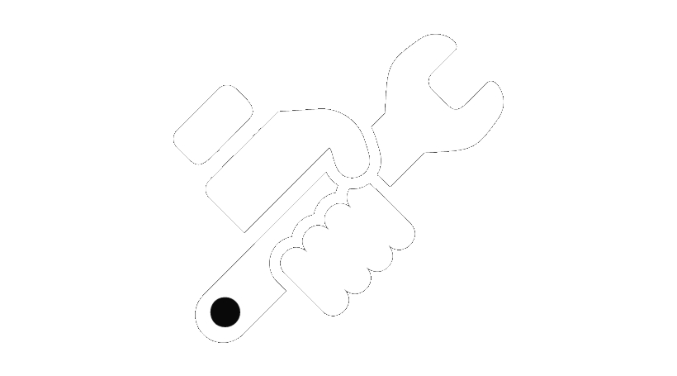


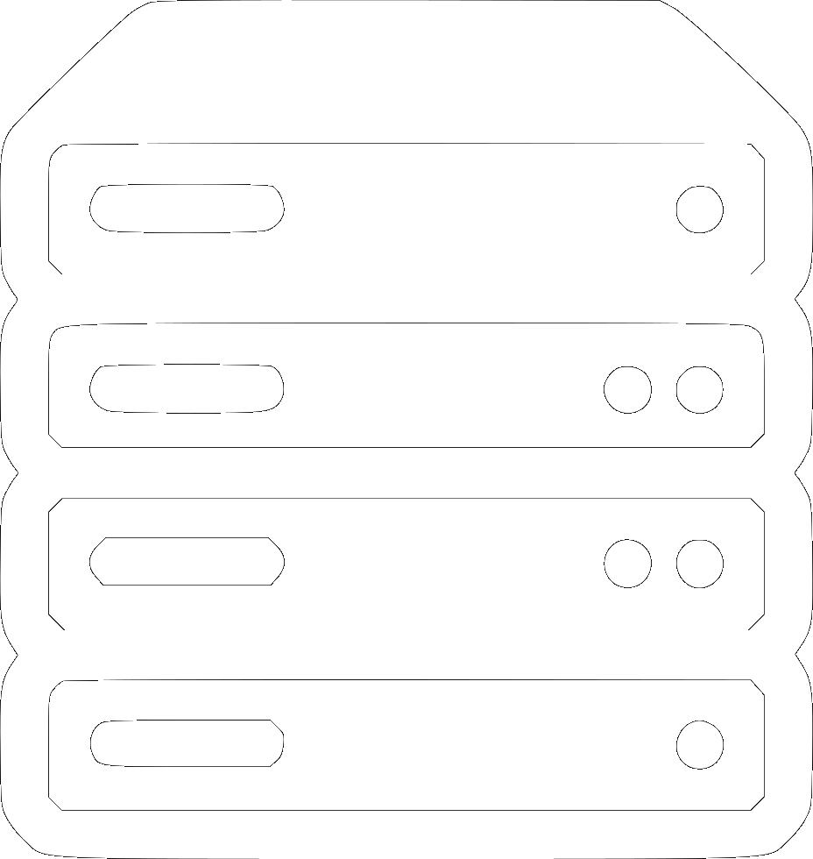

Online Voting: a visual representation
Notes:
Piattaforma Rousseau
we TRUST that these do their job

Slide 10



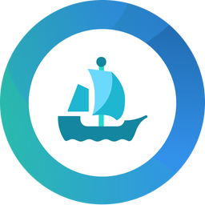


WEB3 or the Decentralized Web
NODEs
NODEs
DECENTRALIZED
PEER2PEER
UNCENSORABLE
TRANSPARENT & ANONYMOUS
TRUSTLESS
PUBLIC
INTERNET
DAPPS
Notes:
NODES ARE COPIES OF THE BLOCKCHAIN RUNNING ON COMPUTERS AROUND THE WORLD

Slide 11


On-chain voting representation
VOTING
DAPP

Slide 12
What does a blockchain look like?
BANK STATEMENT
BLOCKCHAIN
Date | Description | Debit | Credit | Balance
25/5/21 | payment | 6 |  | 300
26/5/21 | withdraw | 3 |  | 297
29/5/21 | deposit |  | 10 | 307
1/6/21 | payment | 5 |  | 302
txn | From | To | Value | Data
0xa4 | 0x8934 | 0xb345 | 6 | bytecode
0xa5 | 0xc8a7 | 0xba52 | 3 | bytecode
0xa5 | 0xe7f32 | 0x485c | 10 | bytecode
0xa6 | 0xb339 | 0x90d3 | 5 | bytecode
0xc3f...aab = “Hash”
Notes:
ema feed:
bank statement is p2p, blockchain can be person to contract
how this is implied with certification?
show etherescan
Bank Statement is A leger or spreadsheet where:
you can’t alter a row to give yourself more cash
organized by date/time
the dates organized by month
private to the bank
BC is A leger or spreadsheet where:
you can’t alter a row to give yourself more cash
organized by transaction number
the txns organized by blocks
public to everyone (but anonymous) → how do NGOs guarantee donors’ privacy

Slide 13
Txn From To Value Data
0xa4...
Luigi
Frank
1
Thanks
Block N
0xa5...
Alice
Bob
0.5
Paid
0xa6...
Bob
Sam
2
0xa7...
Chiara
Contract
0
Vote for #1
Block N+1
0xa8...
Rob
Contract
0
Vote for #2
0xa9...
Carlo
Matteo
12.5
ricevuto!
0xa10...
Leo
Contract
0
vote
Block N+2

Slide 14
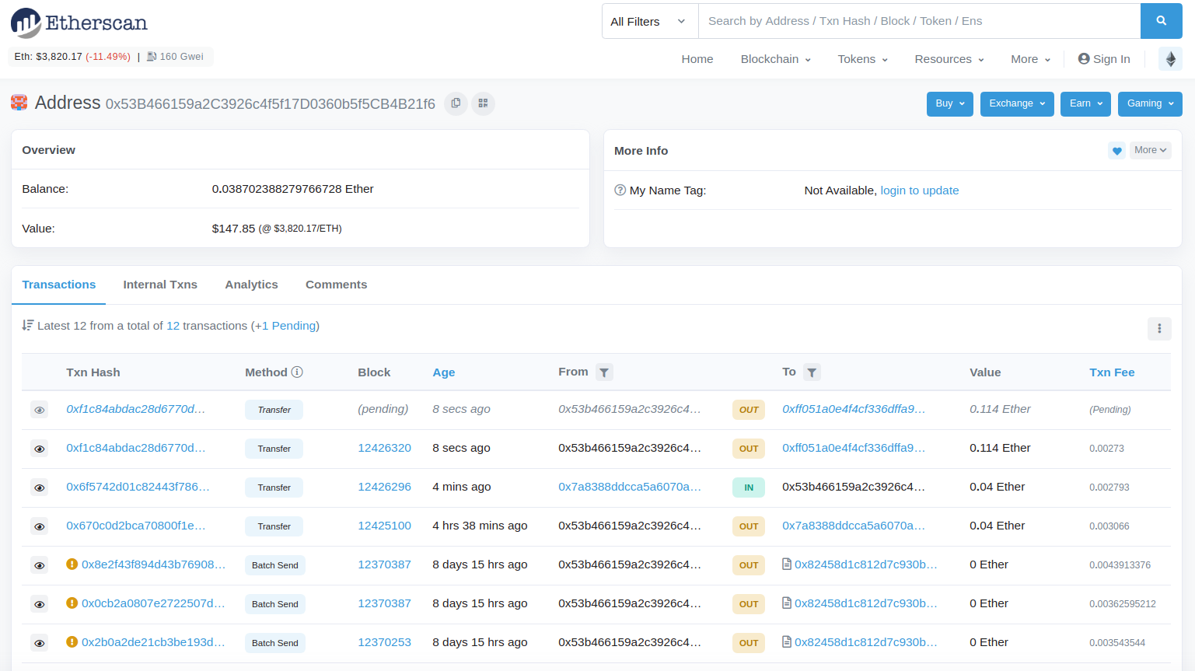
Notes:
ema feed:
bank statement is p2p, blockchain can be person to contract
how this is implied with certification?
show etherescan
A leger or spreadsheet where:
you can’t alter a row to give yourself more cash
organized by date/time
the dates organized by month
private to the bank
A leger or spreadsheet where:
you can’t alter a row to give yourself more cash
organized by transaction number
the txns organized by blocks
public to everyone

Slide 15
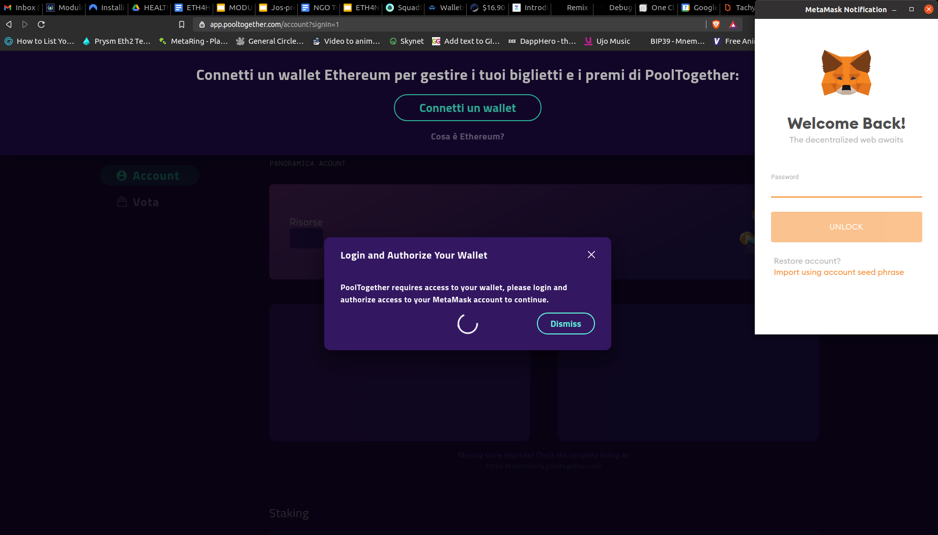
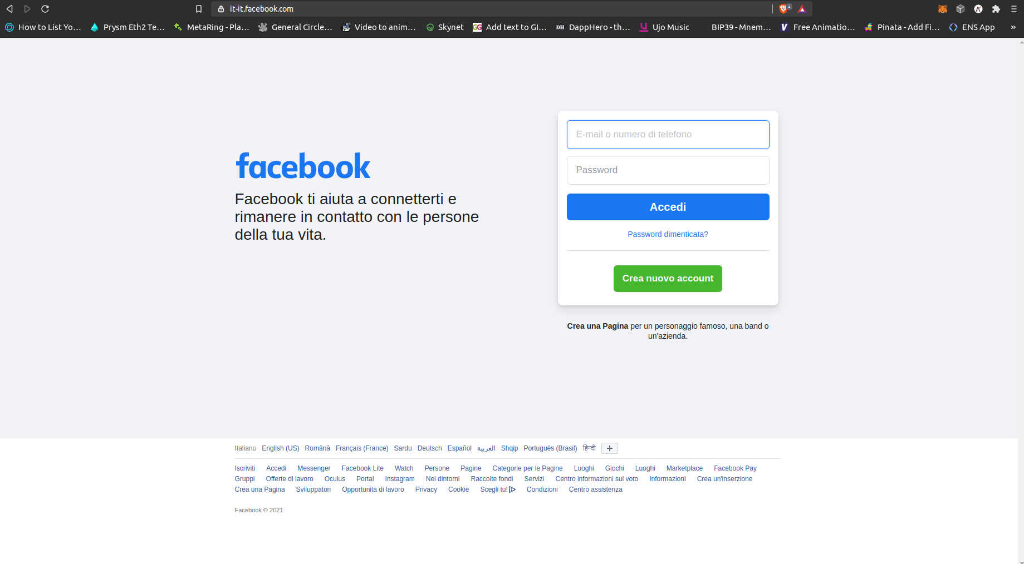
How to access the blockchain?
Notes:
DEMO SCREENSHARE = login facebook and login WEB3
LOGIN TO METAMASK is LOCALLY!!!!

Slide 16
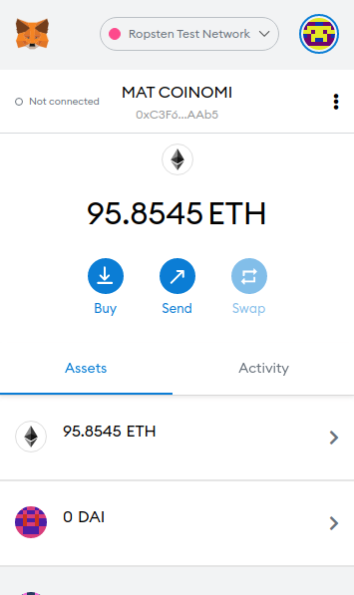
Notes:
DEMO SCREENSHARE = login facebook and login WEB3

Slide 17
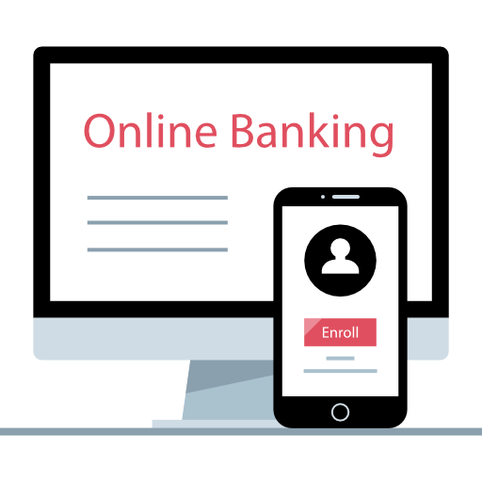
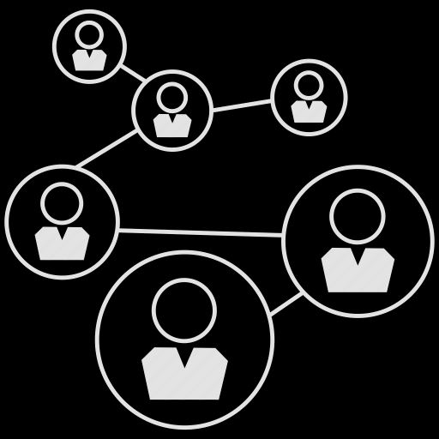

Social and Finance on the Internet
WEB 2
WEB 3
PROFILE
ACTIVITY
ACCOUNT
TRANSACTIONS
PROFILE is ACCOUNT
ACTIVITIES are TRANSACTIONS

Slide 18
Objectives and types of Fundraising in NGOs
OBJECTIVE | TYPE OF FUNDRAISING
Campaigns | Unrestricted funds (one time and RID donations)
Projects | Grants, EU Funding
Running Costs | all the above
Notes:
Ema Feed: keep this slide empty, we fill it up with participants
WHAT / TYPE
Campaigns / unrestricted funds (smaller donations)
Projects / restricted funds (money for - , EU funding etc)
Running costs - staff /

Slide 19
What are the pros and cons of fundraising as it is today?
 | PROS | CONS
TRADITIONAL | anonymity all-size donations | not traceable do not help long term stategies and budgeting
DIGITAL | KYC on-going donations allow long term planning | breaks anonymity censorable (e.g. if dictatorship) bank or payment apps as middlemen
Notes:
FILL this is with the audience

Slide 20

Traditional Funding: a visual representation
SECTION A
RID
OPERATOR
PRIVATE
GRANTS
SECTION B
FREE DONATIONS
BANK
ACCOUNT
requests
ADMINISTRATORS
PUBLIC FUNDING
SECTION C
MERCHANDISE
Notes:
ema feed:
ask what do participants think of this visual representation?

Slide 21
On-chain fundraising visual representation
Donors
SECTION A
SMART CONTRACT FOR FINANCE AND VOTING
PROPOSA
L
S
ONE-TIME DONATIONS
SECTION B
ONGOING
DONATION
MERCH SALE
SECTION C
PUBLIC VOTING
DIRECT TRANSFER OF FUNDS, NO MIDDLE MEN

Slide 22
WALLETs
Pseudo-Anonymity
Digital Signature
Password Responsibility
Rob’s Wallet
0x123abc...789a4b
or
roberto.eth

Slide 23

SMART CONTRACTs
software that runs on the blockchain = public and decentralized. It contains a list of rules.
EXAMPLE
I am a shepherd.
I want to save my sheep in a list that:
shows I own them
is a public list
If I registered the sheep with my city, I would have to trust the city’s record keeper & their servers
Only the owner of a sheep can transfer its ownership to someone else. Everytime a sheep is sold, the new owner displays on the registry automatically (I don’t need a public functionary to update it)
ROB the SHEPHERD’s
SHEEP CONTRACT
0x05854cA140caB11e2f5AAb284c6AB5415f96E26B

Slide 24
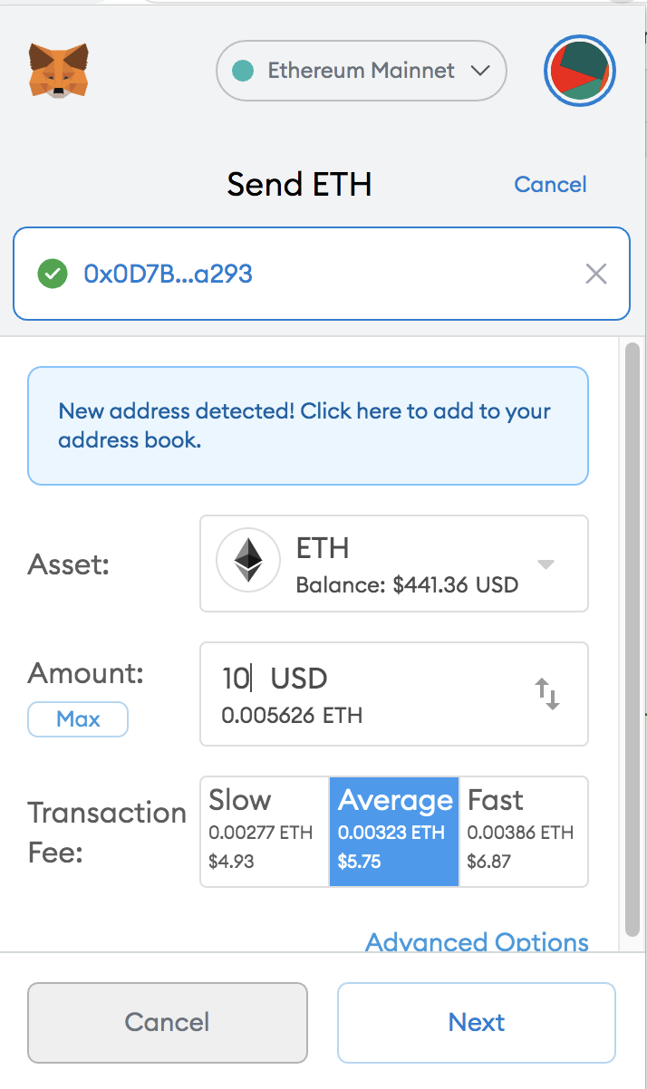

ETHER (ETH)
Is the native token of the Ethereum Blockchain
Miners get paid in Ether to glue the blocks together
In order to interact with the Ethereum Blockchain, you need a personal balance of ETH, because the Ethereum network charges you (in “Gas”) for:
saving information
computing

Slide 25
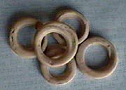
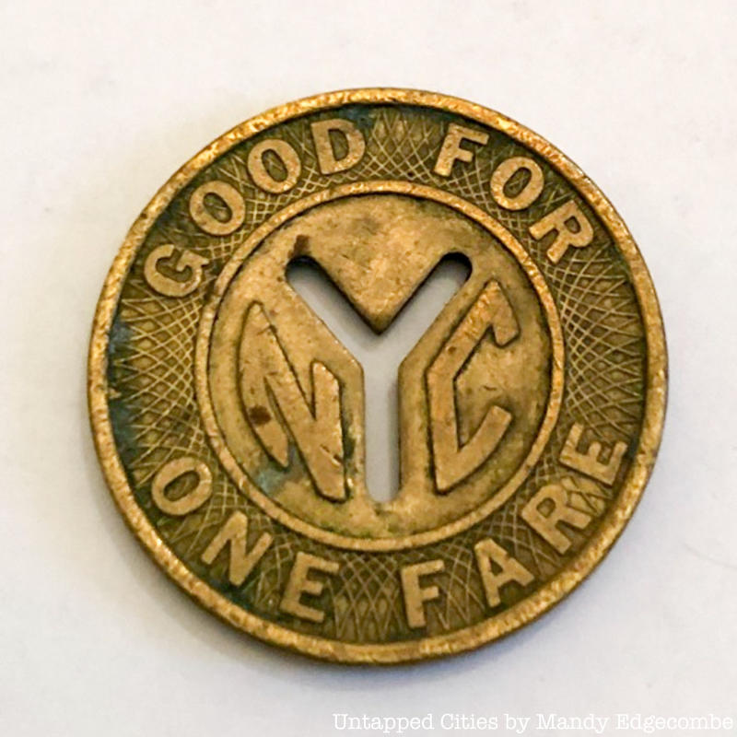
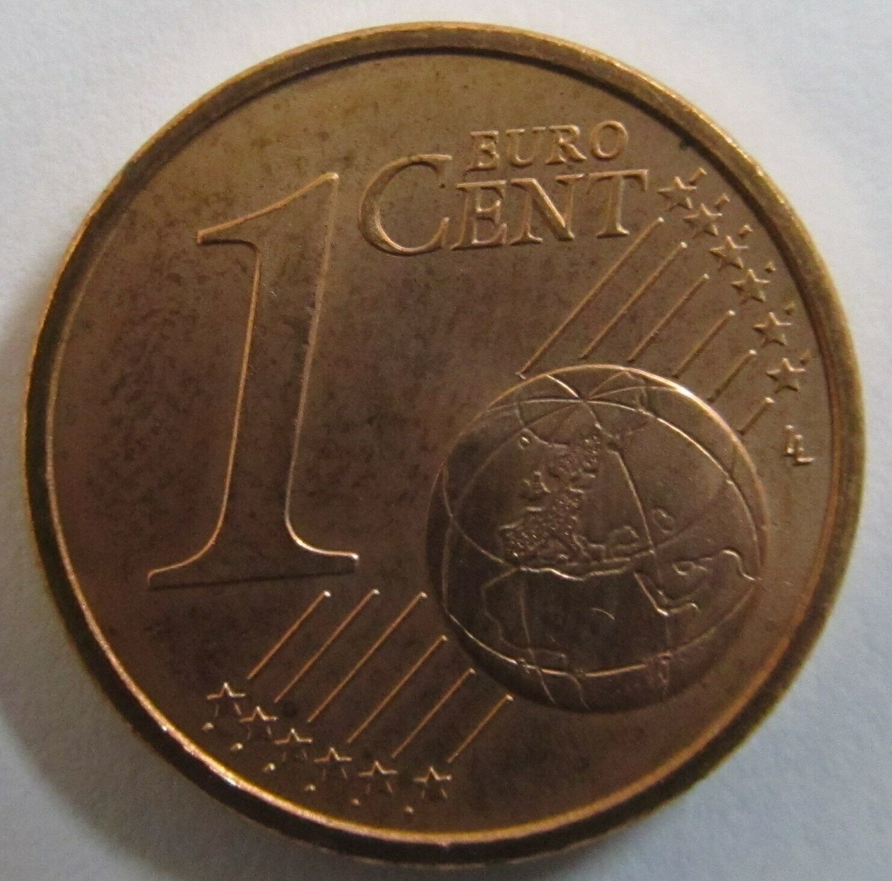
TOKENs
From the Old English tacen, meaning “sign, symbol, evidence”. Tokens are symbolic objects that are discrete, scarce, tradable, community-driven and community-defining
Tokens store value and meaning
A voucher that can be exchanged for goods or services. Sometimes the token operates certain machines (laundry, car wash, etc)
Physical money is made of “tokens of value”
Token question time

Slide 26



ERC20 - FUNGIBLE TOKENs
Custom money
Token Standard (same base Smart Contract)
Contains the lists of Value Holders’ Addresses
They are “fungible” and “swappable”
(e.g. 10 tokens of Project A can be exchanged for 2 tokens of Project B)
Many startups use these tokens to:
govern their Decentralized Apps (DApps)
raise funds

Slide 27
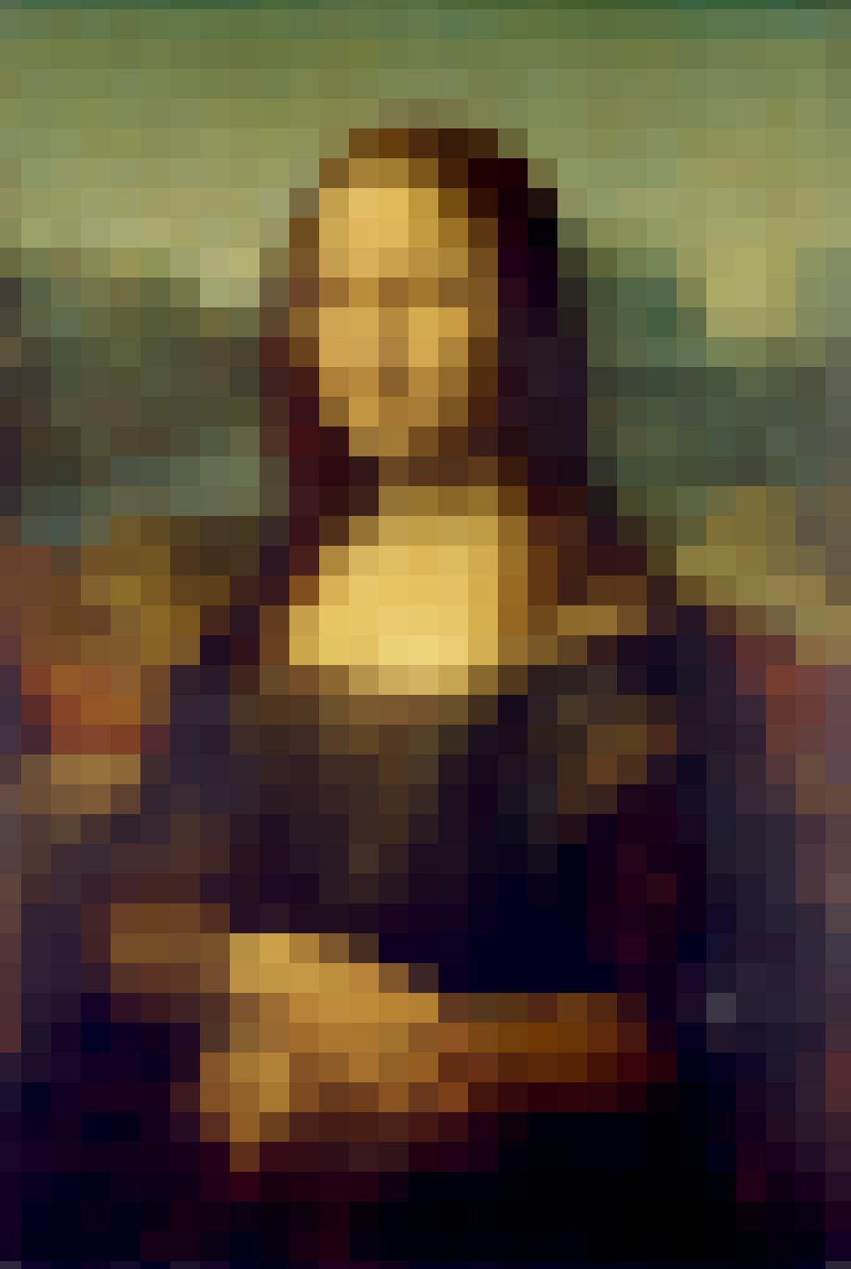
ERC721 - NON FUNGIBLE TOKENs (NFTs)
Each token is unique
The token can represent ownership of copyrights / royalties / licenses / tickets, anything that the Author associated with the NFT
An example rule: The Author can receive royalties every time the NFT is sold on the secondary market
QUESTION: What does it mean to own a digital thing?
Who owns it
NFT
Address of artwork on IPFS
Rules: eg: like 10% of resales go to original creator

Slide 28

DAPPs
like Apps, but they are decentralized in
software (smart contracts)
storage (blockchain + IPFS)
Governed by token holders
Cannot be censored

Slide 29
DAOs - Decentralized Autonomous Organizations
Wallet
Voting
Payments
Rules / Governance

Slide 30
ASSIGNMENT:
CREATE A PROTOTYPE OF DIGITAL COLLECTIBLE (NFT) FOR YOUR NGO
THINK WHAT USE IT COULD HAVE (VOTING POWER, VOUCHER, MEMBERSHIP etc)

Slide 31
DEMO TIME

Slide 32
EDUCATIONAL PURPOSE
Smart Contracts are an interoperable environment (like LEGO)
You don’t need to be a software developer to build on Ethereum

Slide 33
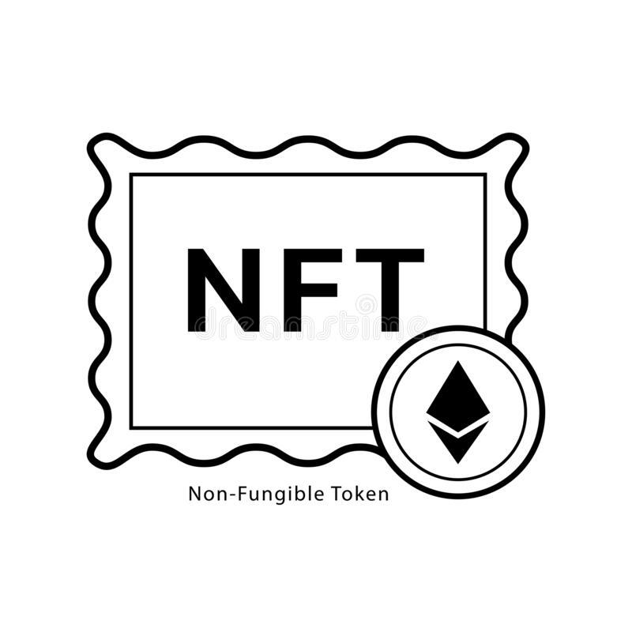
DEMO TIME: on-chain Fundraising & Governance
NGO’s
DAO / MULTISIG
NGO MERCH
NFT STORE
Member
$
President
Activist

Slide 34
Mixture DAO (NGO) - NFT Fundraising
Membership card | “thank you” NFTs for donation
Limited edition NGO anniversary digital posters | NFT unconditional cash grant
NGO / Artist Collaboration Event Conference | certification of ownership some memorabilia
Tickets for online event / streaming

Slide 35
FEEDBACK
we need DAOs that can create NFTs and sell them directly, without passing via a personal wallet
NGO tech admin might need to welcome members into a DAO w/o knowing what address is who
DAO voting should be also be made anonymous.

